Slide 1
IS 436 Deliverable 5
By: Jessica Park, Farah Siddiqui, Betelhem Taddele, Danny Nguyen, Jatin Chauhan, Munam Ghazanfar, Ninh Ngo, Adil Mufti

Slide 2
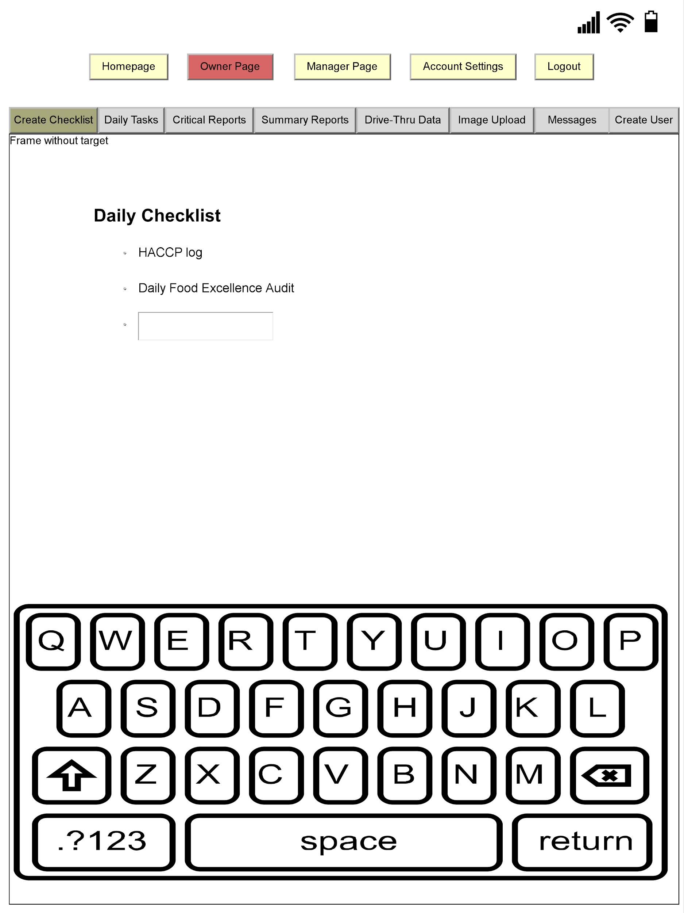
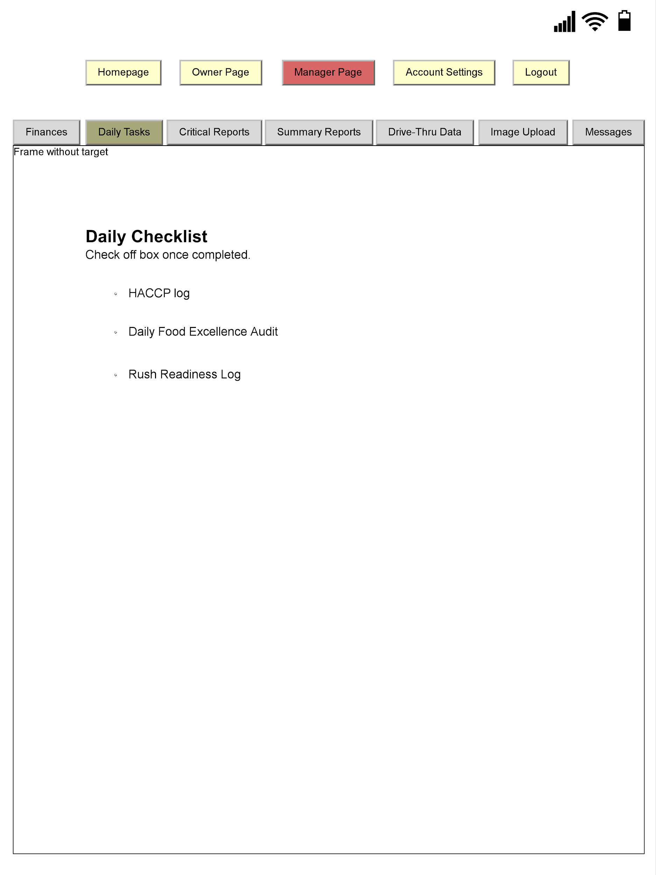
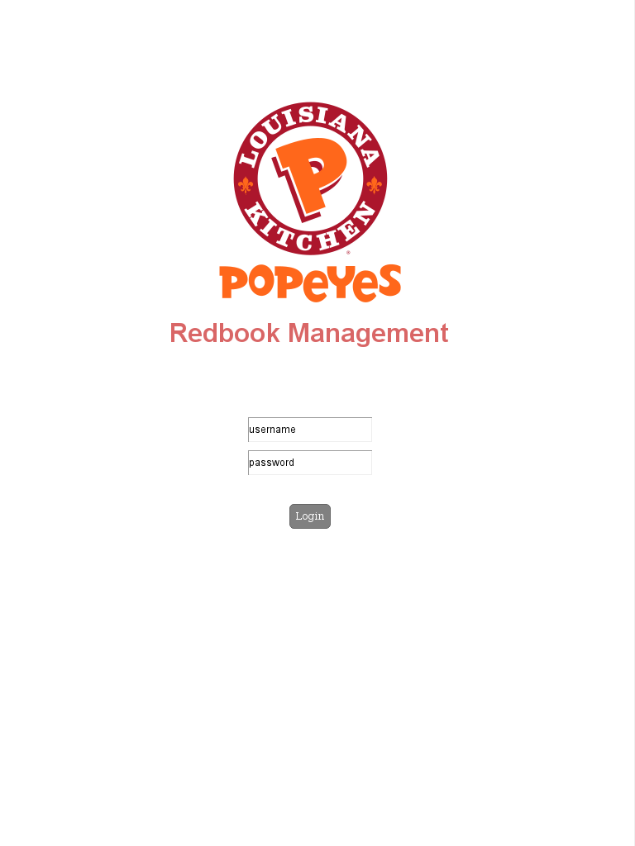
User Interface Design

Slide 3
Interface Standards
Input: owner is able to create a checklist and manager is able to mark off what has been completed
Output: a list of completed tasks are automatically compiled on a separate page which the owner can access
Information is stored on cloud

Slide 4
Interface Standards continued
All links are uniform and consistent in placement, size, and shape
Users will know their current page based on red highlights
Top page: navigation area
Middle page: content area
Bottom page: work area

Slide 5
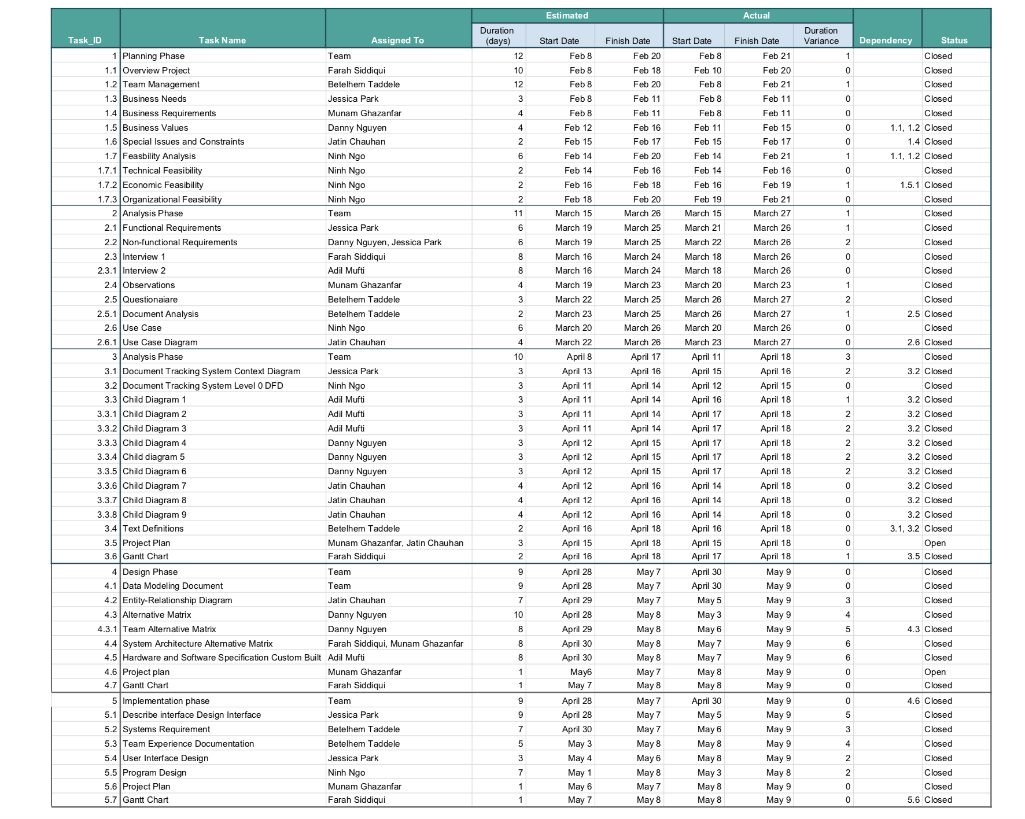
Updated Project Plan

Slide 6
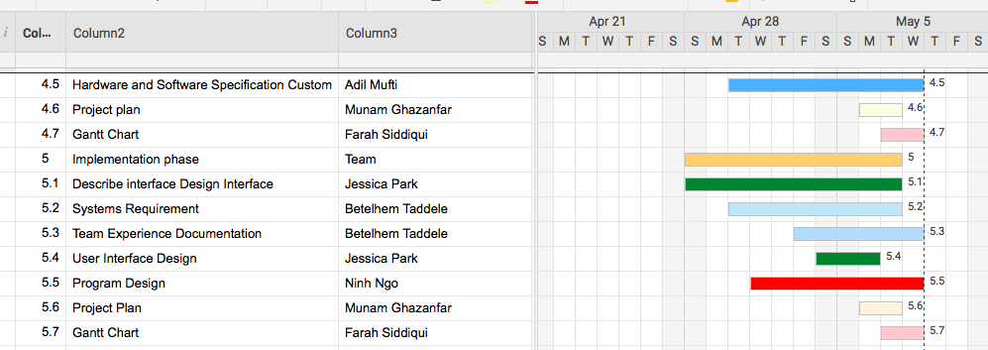
Gantt Chart

Slide 7
Program Design - Prototype Demo
https://swe.umbc.edu/~lx04615/is436/is_436_project_login.html

